Slide 1





Diagram 1/7: 100% Customer Managed/Lift and Shift using AWS as IaaS only
AWS Cloud
AWS Region (Citrix CVAD ‘Site’)
VPC
Private Citrix VDA Subnet 1
Private Citrix Infrastructure Subnet 1
Public Subnet 1
EC2
EC2
EC2
NAT Gateway
Availability Zone 1
EC2
SQL Databases
Citrix Licensing
RD
Citrix ADC/
Gateway VPX
Citrix StoreFront
RD Gateway
VDA’s (Apps and Desktops)
Citrix Delivery Controller
Auto
Scaling
Internet
Citrix Resource Layer
Citrix Control Layer
Citrix Access Layer
RD
Citrix Delivery Controller
RD Gateway
Availability Zone 2
Citrix StoreFront
Citrix ADC/
Gateway VPX
VDA’s (Apps and Desktops)
SQL Databases
Citrix Licensing
Private Citrix VDA Subnet 2
Private Citrix Infrastructure Subnet 2
Public Subnet 2
NAT Gateway

Slide 2


Citrix Cloud Services
Diagram 2: 100% Cloud Services on AWS with AWS Managed Services - Greenfield
Virtual Apps and Desktops
Workspace
Gateway
Analytics
AWS Cloud
AWS Region (Citrix CVADS ‘Resource Location’)
AWS VPC
Diagram 13: CVADS Resource Location design pattern with separate subnets for VDA’s and Cloud Connectors
Private Citrix VDA Subnet 1
Private Citrix Infrastructure Subnet 1
Public Subnet 1
Optional
EC2
EC2
NAT Gateway
Availability Zone 1
EC2
AWS Managed Active Directory
Citrix Cloud Connector
RD
VDA’s (Apps and Desktops)
RD Gateway
Internet
AWS Services
Auto
Scaling
Citrix Resource Layer
Citrix Control Layer
RD
AWS Managed File System
RD Gateway
Availability Zone 2
Citrix Cloud Connector
VDA’s (Apps and Desktops)
Private Citrix VDA Subnet 2
Private Citrix Infrastructure Subnet 2
NAT Gateway
Public Subnet 2

Slide 3
Citrix Cloud Services
Diagram 2: Design Pattern for a regional Resource Location
Virtual Apps and Desktops
Workspace
Gateway
Analytics
AWS Cloud
AWS Region (Citrix CVADS ‘Resource Location’)
AWS VPC
Private Citrix VDA Subnet 1
Private Citrix Infrastructure Subnet 1
Public Subnet 1
Optional
EC2
EC2
Availability Zone 1
AWS Managed Active Directory
Citrix Cloud Connector
NAT Gateway
VDA’s (Apps and Desktops)
Internet
AWS Services
Citrix Resource Layer
Citrix Control Layer
Availability Zone 2
AWS Managed File System
Citrix Cloud Connector
NAT Gateway
VDA’s (Apps and Desktops)
Private Citrix VDA Subnet 2
Private Citrix Infrastructure Subnet 2
Public Subnet 2

Slide 4

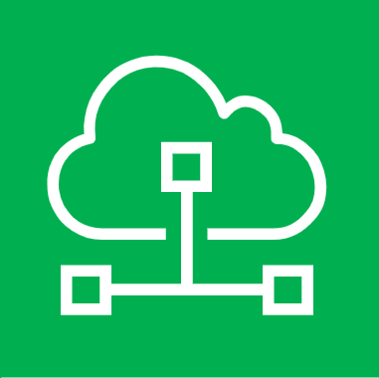
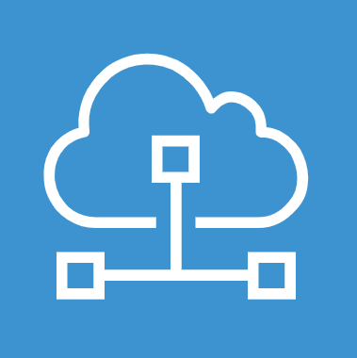
AWS Cloud Region
Availability Zone 1
Availability Zone 2
VPC
Diagram 3: Deployed architecture detail using the CVADS on AWS QuickStart template and default parameters.
Update for CVADS on AWS QuickStart Template deployment guide
Public Subnet 1
Public Subnet 2
RD
RD
Auto
Scaling
NAT Gateway
RD Gateway
RD Gateway
NAT Gateway
10.0.4.0/24
10.0.5.0/24
Private Citrix Infrastructure Subnet 1
Private Citrix Infrastructure Subnet 2
Citrix Cloud Connector
Citrix Cloud Connector
10.0.0.0/24
AWS Active Directory
Service
10.0.1.0/24
Private Citrix VDA Subnet 1
Private Citrix VDA Subnet 2
Citrix VDA
Citrix VDA
10.0.3.0/24
VPC CIDR: 10.0.0.0/16
10.0.4.0/24

Slide 5
Citrix Cloud Services
Diagram 4: CVADS Hybrid Deployment Model on AWS
Virtual Apps and Desktops
Workspace
Gateway
Analytics
AWS Cloud
AWS Region (Citrix Cloud ‘Resource Location’)
VPC
Private Citrix VDA Subnet 1
Private Citrix Infrastructure Subnet 1
Public Subnet 1
Optional
EC2
EC2
Optional
EC2
NAT Gateway
Availability Zone 1
EC2
AWS Managed Active Directory
RD
Citrix Cloud Connector
Citrix StoreFront
Citrix ADC/
Gateway VPX
RD Gateway
VDA’s (Apps and Desktops)
Internet
AWS Services
Auto
Scaling
Citrix Resource Layer
Citrix Control Layer
Citrix Access Layer
RD
AWS Managed File System
RD Gateway
Availability Zone 2
Citrix Cloud Connector
Citrix StoreFront
Citrix ADC/
Gateway VPX
VDA’s (Apps and Desktops)
Private Citrix VDA Subnet 2
Private Citrix Infrastructure Subnet 2
Public Subnet 2
NAT Gateway

Slide 6

Citrix Cloud Services
Diagram 5: Conceptual Architecture, CVADS: Hybrid Deployment/Hybrid Cloud Model
Virtual Apps and Desktops
Workspace
Gateway
Analytics
AWS Cloud
AWS Region (Citrix Cloud ‘Resource Location’)
VPC
Private Citrix VDA Subnet 1
Private Citrix Infrastructure Subnet 1
Public Subnet 1
Optional
EC2
EC2
Optional
EC2
NAT Gateway
Corporate Datacenter (Citrix Cloud ‘Resource Location’)
Availability Zone 1
EC2
Internet
AWS Managed Active Directory
RD
Optional
Citrix Cloud Connector
Citrix StoreFront
Citrix ADC/
Gateway VPX
RD Gateway
VDA’s (Apps and Desktops)
Access
Auto
Scaling
StoreFront x2
Citrix ADC/
Gateway x2
AWS Services
Citrix Resource Layer
Citrix Control Layer
Citrix Access Layer
RD
Control
Cloud Connectors
AWS Managed File System
RD Gateway
AWS Direct Connect / VPN or Citrix SD-WAN
Availability Zone 2
Citrix Cloud Connector
Citrix StoreFront
Citrix ADC/
Gateway VPX
File Services
VDA’s (Apps and Desktops)
Resources
Private Citrix VDA Subnet 2
Private Citrix Infrastructure Subnet 2
Public Subnet 2
NAT Gateway
Active Directory
VDA’s (Apps and Desktops)

Slide 7
Citrix Cloud Services
Diagram 6: Conceptual Architecture, CVAD: Lift and Shift Deployment Model on AWS
Virtual Apps and Desktops
Workspace
Gateway
Analytics
AWS Cloud
AWS Region (Citrix Cloud ‘Resource Location’)
VPC
Private Citrix VDA Subnet 1
Private Citrix Infrastructure Subnet 1
Public Subnet 1
Optional
EC2
EC2
Optional
EC2
NAT Gateway
Availability Zone 1
EC2
Internet
AWS Managed Active Directory
RD
Citrix Cloud Connector
Citrix StoreFront
Citrix ADC/
Gateway VPX
RD Gateway
VDA’s (Apps and Desktops)
AWS Services
Auto
Scaling
Citrix Resource Layer
Citrix Control Layer
Citrix Access Layer
RD
AWS Managed File System
RD Gateway
Availability Zone 2
Citrix Cloud Connector
Citrix StoreFront
Citrix ADC/
Gateway VPX
VDA’s (Apps and Desktops)
Private Citrix VDA Subnet 2
Private Citrix Infrastructure Subnet 2
Public Subnet 2
NAT Gateway

Slide 8
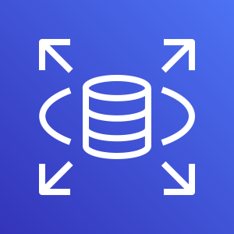
Diagram 8: Conceptual Architecture, CVAD: Lift and Shift Deployment Model with Hybrid Cloud Infrastructure and AWS managed cloud services.
AWS Cloud
AWS Region (Citrix CVAD ‘Site’)
VPC
Private Citrix VDA Subnet 1
Private Citrix Infrastructure Subnet 1
Public Subnet 1
Optional
EC2
EC2
EC2
NAT Gateway
Corporate Datacenter (Citrix Cloud ‘Resource Location’)
Availability Zone 1
EC2
Internet
Citrix Licensing
RD
AWS Managed Active Directory
Citrix ADC/
Gateway VPX
Optional
Citrix StoreFront
RD Gateway
VDA’s (Apps and Desktops)
Citrix Delivery Controller
Access
Citrix Licensing
AWS Services
Auto
Scaling
StoreFront x2
Citrix ADC/
Gateway x2
AWS RDS for SQL Server
Citrix Resource Layer
Citrix Control Layer
Citrix Access Layer
RD
Control
SQL Databases
AWS Managed File System
Citrix Delivery Controller
RD Gateway
AWS Direct Connect / VPN or Citrix SD-WAN
Citrix Delivery Controllers
Availability Zone 2
Citrix StoreFront
Citrix ADC/
Gateway VPX
VDA’s (Apps and Desktops)
Citrix Licensing
File Services
Resources
Private Citrix VDA Subnet 2
Private Citrix Infrastructure Subnet 2
Public Subnet 2
NAT Gateway
VDA’s (Apps and Desktops)
Active Directory

Slide 9
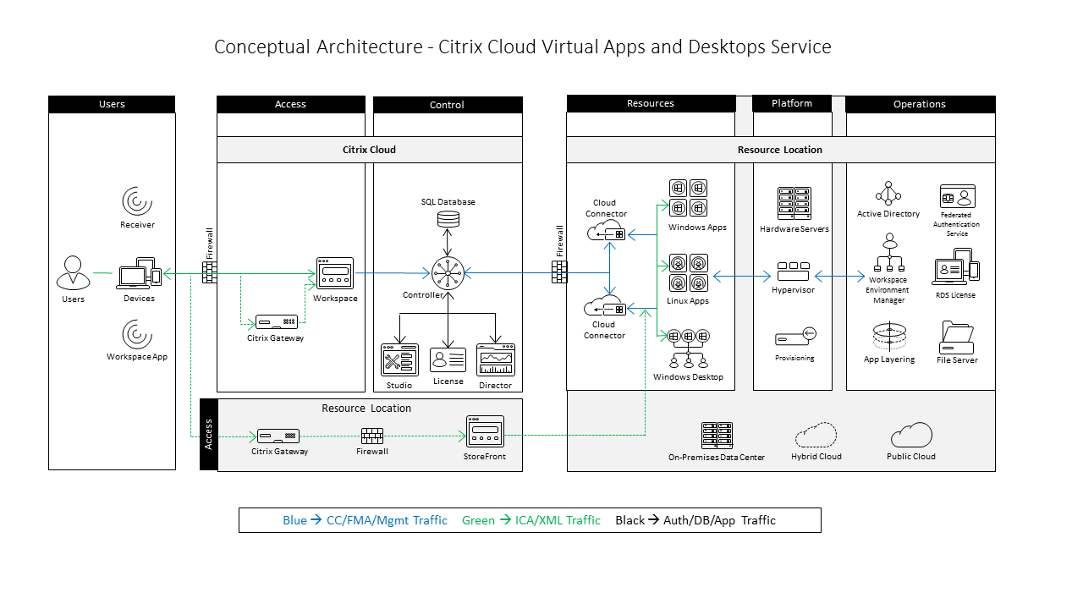
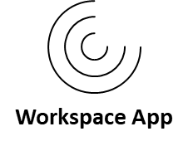
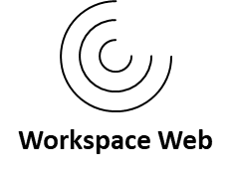
Diagram 9: Conceptual Architecture, Citrix Virtual Apps and Desktops Service
& Desktops

Slide 10
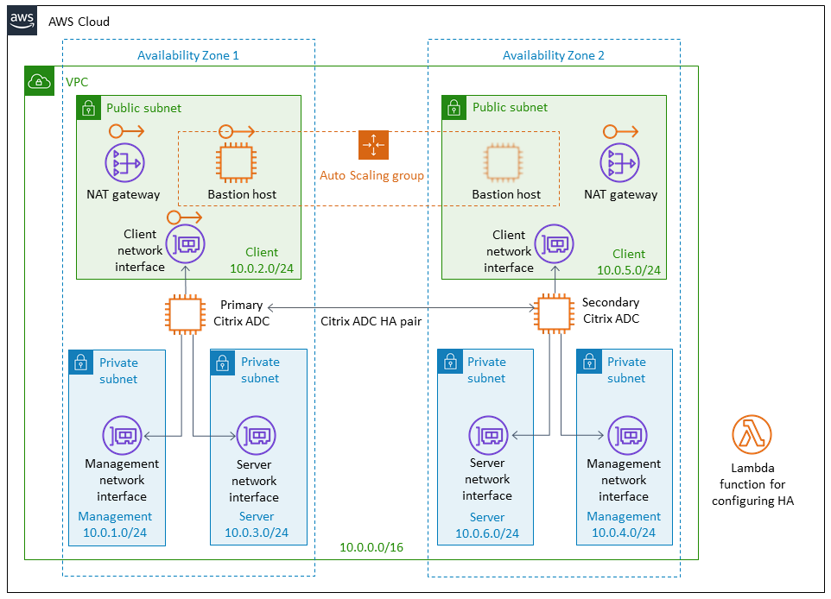
Diagram 10: Conceptual Architecture, Citrix ADC/Gateway VPX on AWS with HA across Availability Zones

Slide 11


Diagram 11: Citrix ADC VPX instance interface mapping for CVAD/CVADS deployments.
AWS Cloud Region
Availability Zone 1
VPC
Public Subnet 1
Gateway vServer (VIP)
NAT Gateway
10.0.4.0/24
Private Citrix Infrastructure Subnet 1
Citrix ADC/
Gateway VPX
Citrix Cloud Connector
ADC Management (NSIP)
10.0.0.0/24
Private Citrix VDA Subnet 1
Subnet IP (SNIP)
Citrix VDAs
10.0.3.0/24
VPC CIDR: 10.0.0.0/16

Slide 12
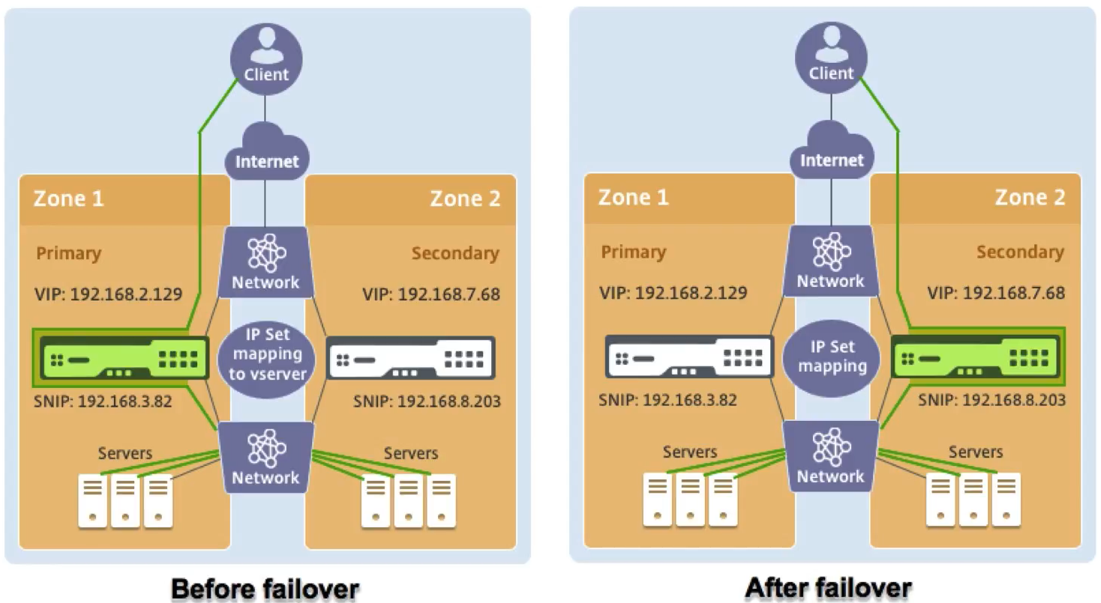
Diagram 12: Traffic flow before and after HA failover in Multi-AZ HA deployment.

Slide 13
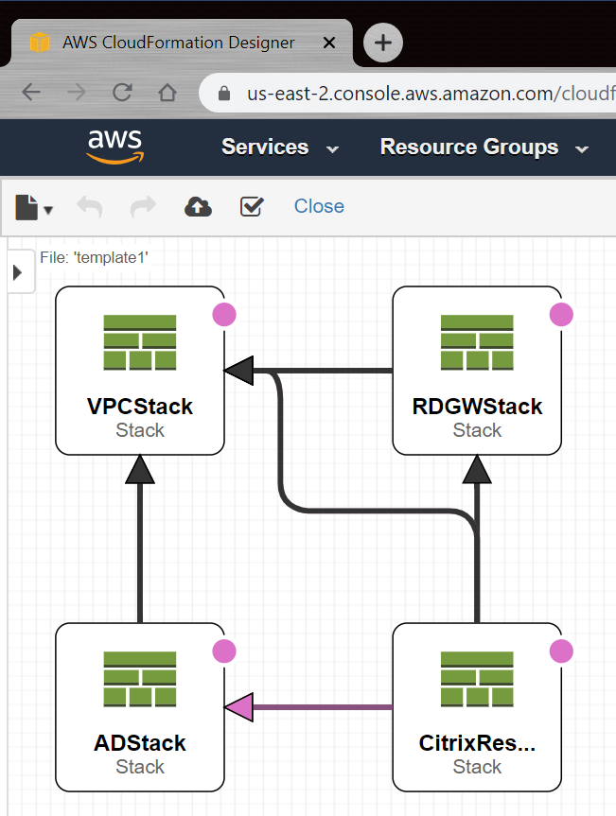
Diagram 15: CVADS template in Cloud Formation Designer with nested stacks.

Slide 14
Diagram 16: VPCStack sample results
AWS Cloud Region
Availability Zone 1
Availability Zone 2
VPC
Public Subnet 1
Public Subnet 2
NAT Gateway
NAT Gateway
10.0.4.0/24
10.0.5.0/24
Private Subnet 1a
Private Subnet 2a
10.0.0.0/24
10.0.1.0/24
Private Subnet 1b
Private Subnet 2b
10.0.3.0/24
VPC CIDR: 10.0.0.0/16
10.0.2.0/24

Slide 15
Diagram 17: VPCStack+ RDGWSTack + ADStack sample build results
AWS Cloud Region
Availability Zone 1
Availability Zone 2
VPC
Public Subnet 1
Public Subnet 2
RD
RD
Auto
Scaling
NAT Gateway
RD Gateway
RD Gateway
NAT Gateway
10.0.4.0/24
10.0.5.0/24
Private Subnet 1a
Private Subnet 2a
10.0.0.0/24
AWS Active Directory
Service
10.0.1.0/24
Private Subnet 1b
Private Subnet 2b
10.0.3.0/24
VPC CIDR: 10.0.0.0/16
10.0.2.0/24

Slide 16
AWS Cloud Region
Diagram 18: CitrixResourceLocationStack (plus nested stacks) sample build results
Availability Zone 1
Availability Zone 2
VPC
Public Subnet 1
Public Subnet 2
RD
RD
Auto
Scaling
NAT Gateway
RD Gateway
RD Gateway
NAT Gateway
10.0.4.0/24
10.0.5.0/24
Private Subnet 1a
Private Subnet 2a
Citrix Cloud Connector
Citrix Cloud Connector
10.0.0.0/24
AWS Active Directory
Service
10.0.1.0/24
Private Subnet 1b
Private Subnet 2b
Citrix VDA
10.0.3.0/24
VPC CIDR: 10.0.0.0/16
10.0.2.0/24

Slide 17
Diagram 14: Deployed “Resource Location” architecture/design pattern from the Citrix Virtual Apps and Desktops Service on AWS Quick Start Cloud Formation template
AWS Cloud Region
Availability Zone 1
Availability Zone 2
VPC
Public Subnet 1
Public Subnet 2
RD
RD
Auto
Scaling
NAT Gateway
RD Gateway
RD Gateway
NAT Gateway
10.0.4.0/24
10.0.5.0/24
Private Citrix Infrastructure Subnet 1
Private Citrix Infrastructure Subnet 2
Citrix Cloud Connector
Citrix Cloud Connector
10.0.0.0/24
AWS Active Directory
Service
10.0.1.0/24
Private Citrix VDA Subnet 1
Private Citrix VDA Subnet 2
Citrix VDA
Citrix VDA
10.0.3.0/24
VPC CIDR: 10.0.0.0/16
10.0.4.0/24

Slide 18

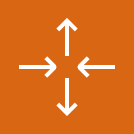






Groups
1/3
AWS Cloud
AWS Cloud
Region
Availability Zone
Security group
Auto Scaling group
VPC
Private subnet
Public subnet
Server contents
Corporate
data center
Elastic Beanstalk container
EC2 instance contents
Spot Fleet
AWS Step Functions workflow
Generic group
Generic group

Slide 19
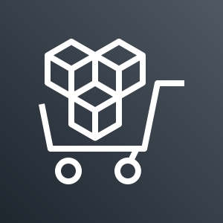
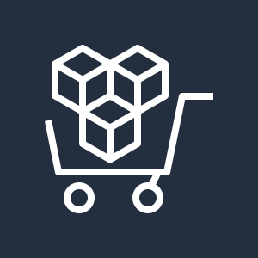



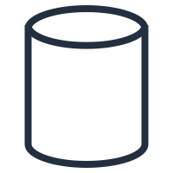
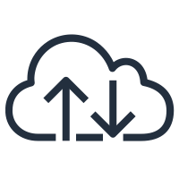

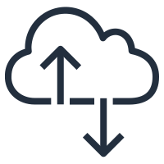










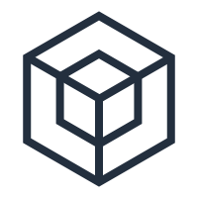
General icons
3/3
AWS Marketplace
AWS Marketplace
Client
Disk
Forums
Generic database
Internet
Internet alt1
Internet alt2
Mobile client
Multimedia
Office building
SAML token
SSL padlock
Tape storage
Traditional server
User
Users
Toolkit
SDK

Slide 20

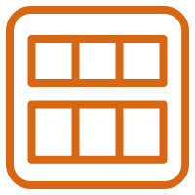



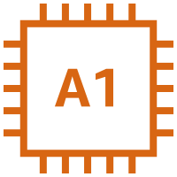
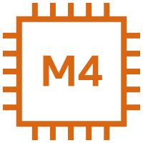
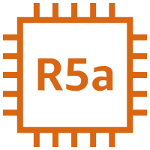
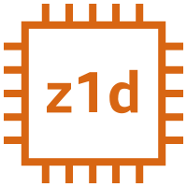



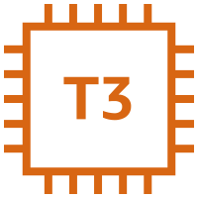

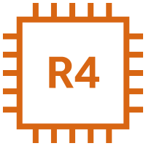
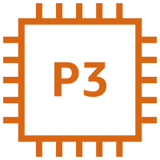
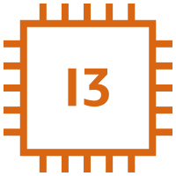

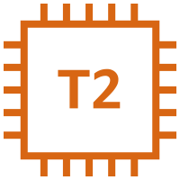

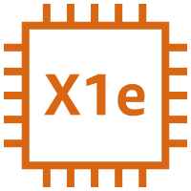

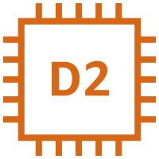


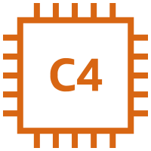
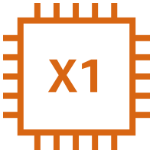


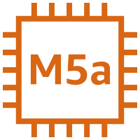



Compute
1/6
AMI
Auto Scaling
Elastic IP address
Rescue
Amazon EC2
Instance
A1 instance
M4 instance
R5a instance
z1d instance
H1 instance
Amazon EC2
Instances
T3 instance
C5 instance
R4 instance
P3 instance
I3 instance
Spot Instance
T2 instance
C5n instance
X1e instance
P2 instance
D2 instance
Instance with CloudWatch
M5 instance
C4 instance
X1 instance
G3 instance
DB instance
M5a instance
R5 instance
High Memory instance
F1 instance

Slide 21


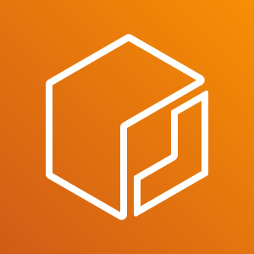





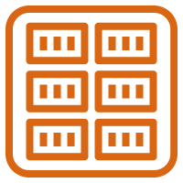






Compute
2/6
Amazon EC2 Auto Scaling
Amazon Application
Auto Scaling
Amazon Elastic Container Registry
Amazon Elastic Container Service
Amazon EC2 Auto Scaling
Amazon Application
Auto Scaling
Amazon Elastic Container Registry
Amazon Elastic Container Service
Registry
Container 1
Container 2
Image
Container 3
Service
Task

Slide 22
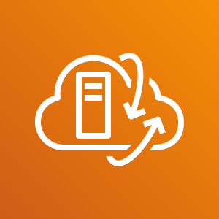
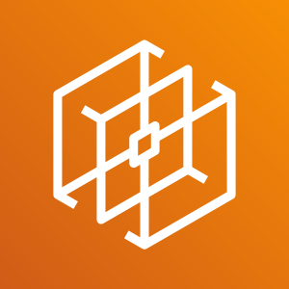



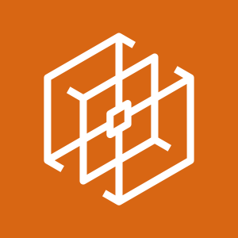


Compute
5/6
VMware Cloud on AWS
AWS Thinkbox Deadline
AWS Thinkbox Draft
AWS Thinkbox Frost
VMware Cloud on AWS
AWS Thinkbox Deadline
AWS Thinkbox Draft
AWS Thinkbox Frost

Slide 23
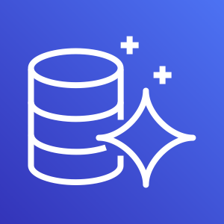
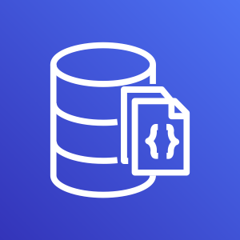

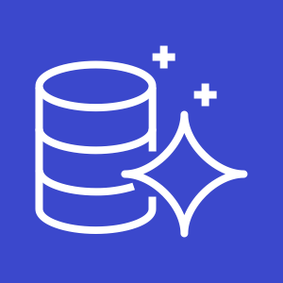
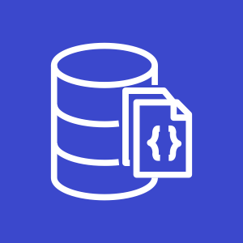



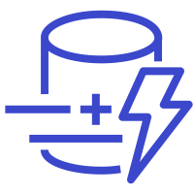




Database
1/4
Amazon Aurora
Amazon DocumentDB (with MongoDB compatibility)
Amazon DynamoDB
Amazon Aurora
Amazon DocumentDB (with MongoDB compatibility)
Amazon DynamoDB
Resource icons on slide 53
Attribute
Items
Amazon DynamoDB Accelerator (DAX)
Item
Table
Attributes
Global secondary index

Slide 24


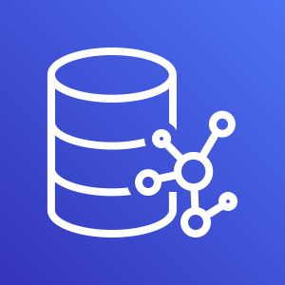
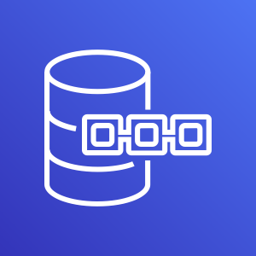
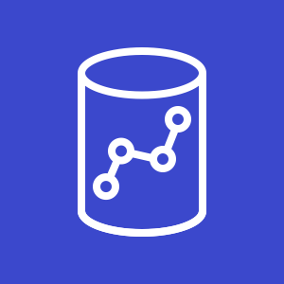

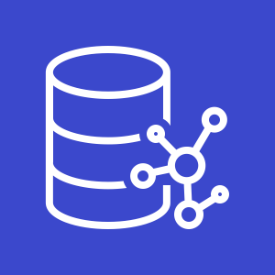
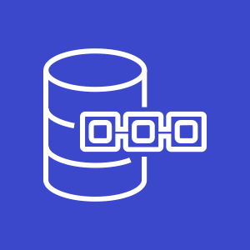
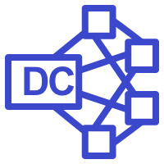

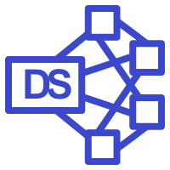
Database
2/4
Amazon Redshift
AWS Database Migration Service
Amazon Neptune
Amazon Quantum Ledger Database
Amazon Redshift
AWS Database Migration Service
Amazon Neptune
Amazon Quantum Ledger Database
Dense compute node
Database migration workflow/job
Dense storage node

Slide 25
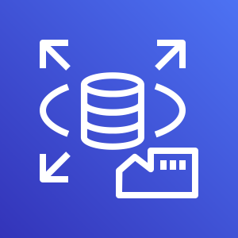
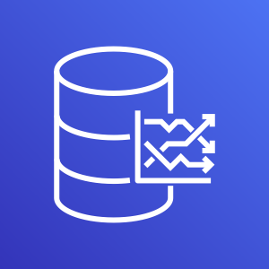








Database
3/4
Amazon RDS
Amazon RDS on VMware
Amazon Timestream
Amazon ElastiCache
Amazon RDS
Amazon RDS on VMware
Amazon Timestream
Amazon ElastiCache
Cache node
ElastiCache for Redis
ElastiCache for Memcached

Slide 26















Database
4/4
Amazon Aurora instance
Amazon Aurora
instance alternate
Amazon RDS instance
Amazon RDS instance alternate
MySQL instance
MySQL instance alternate
Oracle instance
Oracle instance alternate
PostgreSQL instance
PostgreSQL
instance alternate
PIOPS
MariaDB instance
MariaDB instance alternate
SQL Server instance
SQL Server instance alternate

Slide 27














Networking & Content Delivery
1/4
Amazon API Gateway
Amazon CloudFront
Amazon Route 53
AWS PrivateLink
Amazon API Gateway
Amazon CloudFront
Amazon Route 53
AWS PrivateLink
Endpoint
Download distribution
Hosted zone
Edge location
Route table
Streaming distribution

Slide 28














Networking & Content Delivery
2/4
Amazon VPC
Amazon VPC
Customer gateway
Internet gateway
Elastic network interface
Elastic Network Adapter
Endpoints
Router
Traffic Mirroring
NAT gateway
VPN gateway
Flow logs
Network access control list
VPN connection
Peering connection

Slide 29








Networking & Content Delivery
3/4
AWS App Mesh
AWS Cloud Map
AWS Direct Connect
AWS Global Accelerator
AWS App Mesh
AWS Cloud Map
AWS Direct Connect
AWS Global Accelerator

Slide 30











Networking & Content Delivery
4/4
AWS Transit Gateway
AWS Client VPN
AWS Site-to-Site VPN
Elastic Load Balancing
AWS Transit Gateway
AWS Client VPN
AWS Site-to-Site VPN
Elastic Load Balancing
Application Load Balancer
Classic Load Balancer
Network Load Balancer

Slide 31









Security, Identity, and Compliance
1/5
Amazon Cloud Directory
Amazon Cognito
Amazon GuardDuty
Amazon Inspector
Amazon Cloud Directory
Amazon Cognito
Amazon GuardDuty
Amazon Inspector
Agent

Slide 32









Security, Identity, and Compliance
2/5
Amazon Macie
AWS Artifact
AWS Certificate Manager
AWS CloudHSM
Amazon Macie
AWS Artifact
AWS Certificate Manager
AWS CloudHSM
Certificate authority

Slide 33



















Security, Identity, and Compliance
3/5
AWS Directory Service
AWS Firewall Manager
AWS Identity and Access Management
AWS Directory Service
AWS Firewall Manager
AWS Identity and Access Management
Simple AD
Add-on
MFA token
Encrypted data
Long-term security credential
AWS STS
AD Connector
Permissions
Data encryption key
Temporary security credential
AWS STS (alternate)
Role
AWS Managed Microsoft AD

Slide 34









Security, Identity, and Compliance
4/5
AWS Key Management Service
AWS Secrets Manager
AWS Security Hub
AWS Shield
AWS Key Management Service
AWS Secrets Manager
AWS Security Hub
AWS Shield
AWS Shield Advanced

Slide 35





Security, Identity, and Compliance
5/5
AWS Single Sign-On
AWS WAF
AWS Single Sign-On
AWS WAF
Filtering rule

Slide 36












Storage
1/4
Amazon Elastic Block Store
Amazon Elastic File System
Standard Storage Class
Infrequent Access Storage Class
Amazon Elastic Block Store
Amazon Elastic File System
Standard Storage Class
Infrequent Access Storage Class
Snapshot
File system
Volume
Multiple volumes

Slide 37






Storage
2/4
Amazon FSx
Amazon FSx for Lustre
Amazon FSx for Windows File Server
Amazon FSx
Amazon FSx for Lustre
Amazon FSx for Windows File Server

Slide 38











Storage
3/4
AWS Snowball Edge
AWS Snowmobile
AWS Backup
AWS Storage Gateway
AWS Snowball Edge
AWS Snowmobile
AWS Backup
AWS Storage Gateway
Non-cached volume
Cached volume
Virtual tape library

Slide 39














Storage
4/4
Amazon Simple Storage Service
Amazon S3 Glacier
AWS Snowball
CloudEndure Disaster Recovery
Amazon Simple Storage Service
Amazon S3 Glacier
AWS Snowball
CloudEndure Disaster Recovery
Object
Bucket
Vault
Archive
Snowball import-export
Bucket with objects

Slide 40
Diagrams and Icons
Daniel Feller Lead Workspace Architect
January 23, 2020
© 2017 Citrix | Confidential

Slide 41
Icons

Slide 42
Servers, Endpoints and Hardware
Monitor
Tablet
Laptop
Desktop
Device Cluster
Phone
Servers
Server
Virtual Server
Virtual Servers
Thin Client
Hypervisor
Hard Drive
Solid State Drive
Printer
Memory
GPU
CPU
IoT Device Data

Slide 43
NetScaler
NetScaler
NetScaler MAS Console
NetScaler MAS
NetScaler Gateway
NetScaler SD-WAN
HDX Insight
NetScaler

Slide 44
Citrix Virtual Apps and Desktops
StoreFront
Workspace Environment Management
Delivery Controller
Director
Studio
AppDNA
VDA
Beacon
Zones
App Layer(ing)
Federated Authentication Service
Machine Catalog
App Group
Session Recording
License
Receiver
SCOM Packs
Delivery Group
Provisioning Services
Workspace App
Workspace Web

Slide 45
VDA App/Desktop Resources
Windows App
Personal Windows Desktop
Windows Apps
Shared Windows Desktop
Pooled Windows Desktop
Linux App
Linux Apps
VM Hosted Apps
Professional Graphics Desktop
Remote PC Access
Local VM
Pooled Linux Desktop
Shared Linux Desktop
Personal Linux Desktop
Secure Browser Apps
VDI

Slide 46
Citrix Universal Endpoint Management
Secure Forms
Secure Hub
Secure Web
XenMobile
Secure Chat
Secure Mail
Secure Notes
Secure Tasks
Mobile Apps
Device Management

Slide 47
Citrix Files/ShareFile Resources
ShareFile
File Folder
Documents

Slide 48
Cloud
Citrix Cloud
Cloud Connector
XA / XD Service
XenMobile Service
Secure Browser Service
Cloud Storage
Cloud
Hybrid Cloud

Slide 49
Roles and Locations
Users
User
Support
Large Corp
Medium Corp
Small Corp
Home
Data Center / Servers
Factory
Hospital
Finance / Government
Airport
Admin

Slide 50
Operating Systems, Apps and Browsers
Microsoft Word
Microsoft Excel
Microsoft Outlook
Microsoft SharePoint
Microsoft PowerPoint
Microsoft Visio
Windows
Chrome
HTML 5
Android
Linux
Internet Explorer
Opera
FireFox
Safari
Apple
Image
Window
Browser Window
Applications
Linux Image
Windows Image

Slide 51
Miscellaneous Components
Database
Smart Card
Tunnel
Script
Email
XML
File Folder
Access
Locked / Secure
Unlocked
Firewall
Internet
Active Directory
Certificate
Virus / Malware
Smart Card
Bridge
Switch
Network
Router
Document
Documents
Policy
Performance Meter
Drivers / Services
Cache

Slide 52
Citrix Workspace
Conceptual Diagrams

Slide 53
Conceptual Architecture - Generic
Users
Access
Control
Resources
Infrastructure
App Controller
Applications
On-Premises
NetScaler
Cloud
User
Devices
StoreFront
Data Controller
Hybrid Cloud
Data
Management

Slide 54
Conceptual Architecture – Citrix
Users
Access
Control
Resources
Infrastructure
VDI
Browser Apps
Citrix Delivery
Controller
On-Premises
Windows Apps
Linux Apps
Citrix ADC/ Gateway
Cloud
User
Devices
Citrix StoreFront
Citrix Endpoint
Management Controller
Mobile Apps
App Data
Hybrid Cloud
Citrix Files Storage Zone Controller
File Server Storage
Cloud Storage
Automation
Provisioning
Management
Analytics
Monitoring

Slide 55
Citrix Virtual Apps and Desktops
Conceptual Diagrams

Slide 56
Citrix Virtual Apps and Desktops – Customer Managed
Users
Access
Control
Resources
Infrastructure
Database
Cloud
Windows Apps
Devices
Citrix ADC/ Gateway
User
Citrix StoreFront
Controller
Linux Apps
On-Premises
License
Windows Desktop
Studio
Director

Slide 57
Virtual Apps and Desktops – Customer Managed/Hybrid Cloud
Users
Access
Control
Resources
Infrastructure
Database
Cloud
Windows Apps
Devices
Citrix ADC/ Gateway
User
Citrix StoreFront
Controller
Linux Apps
On-Premises
License
Windows Desktop
Studio
Director
On-Premises
- and/or -
Cloud

Slide 58
Virtual Apps and Desktops – Citrix Cloud Services
Users
Access
Control
Resources
Hosts
Database
Cloud Connector
Cloud
Windows Apps
Devices
Citrix ADC/ Gateway
User
Citrix Workspace
Controller
Linux Apps
Cloud Connector
On-Premises
License
Windows Desktop
Studio
Director
Citrix Cloud

